Slide 1
Week 14
Ideally, prior to showing these slides, print the slides and cut up the sentences and pictures. Ask the learners in groups to match them, then work through the slides and ask learners to correct as you go along.
Use the arrows on the keyboard to move forward or click the buttons. Press F5 on the keyboard to start the slideshow.
end show
Notes:
Prepositions of time and present simple tense
Prepositions of place

Slide 2
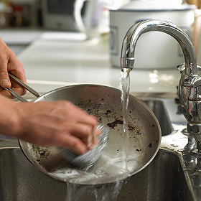
How often do you wash up?
1

Slide 3
I always wash up.
2

Slide 4
How often do you sweep the floor?
3

Slide 5
I never sweep the floor.
4

Slide 6
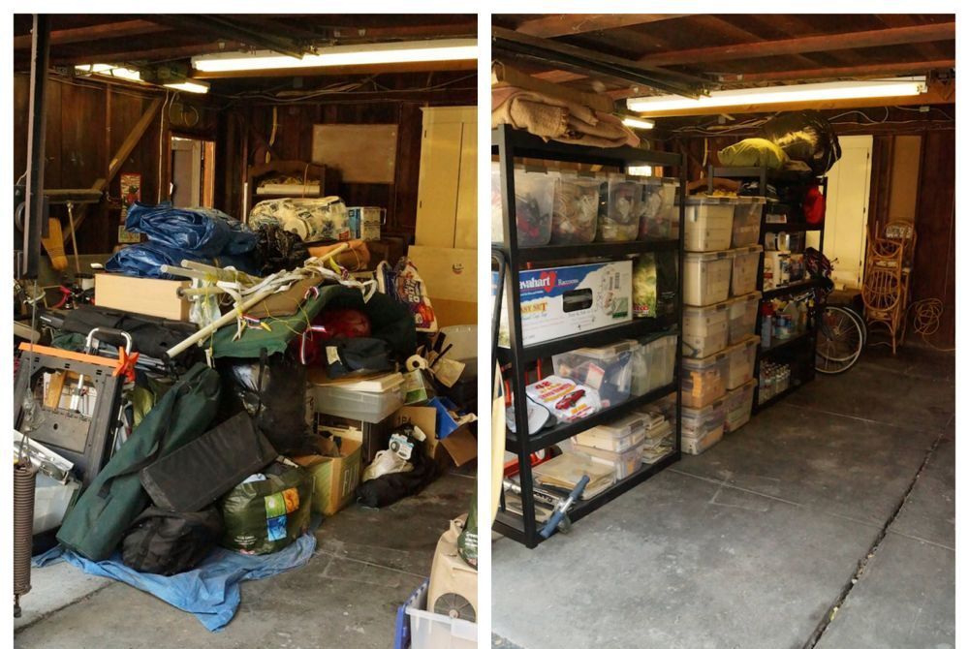
How often do you tidy up?
5

Slide 7
I sometimes tidy up.
6

Slide 8
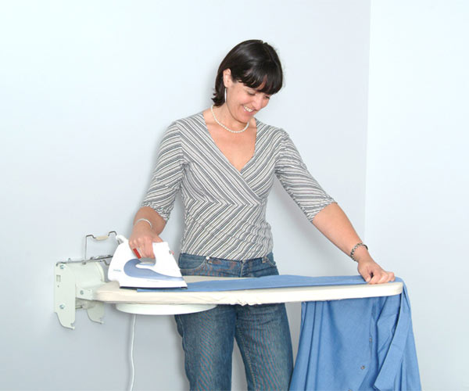
How often do you iron?
7

Slide 9
I usually do the ironing.
8

Slide 10
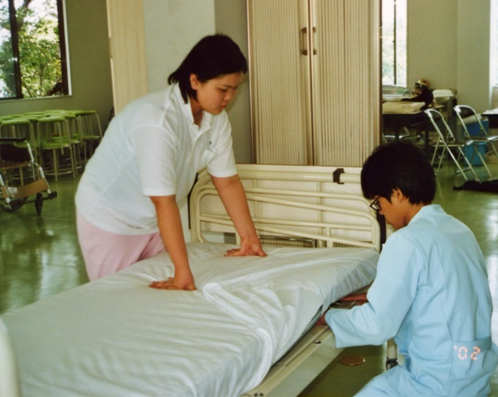
How often do you make the beds?
9

Slide 11
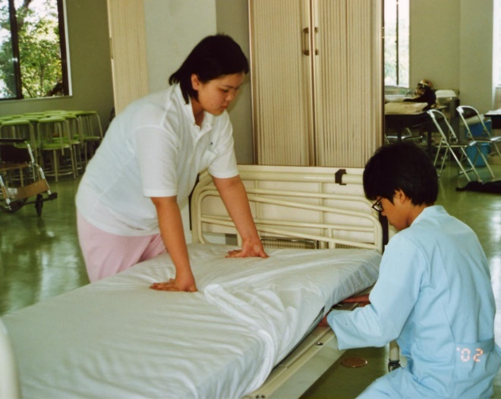
I often make the beds.
10

Slide 12
start again (if needed)
end show
slide 1

