Slide 1
Week 2 Can you help me?
Open this document to cut out words to sequence on page 2.
Provide the worksheets. Display the blank dialogue on slides 2 and 3. Provide cut outs of the words and ask students to sequence the words correctly in each speech bubble.
Use the arrows on the keyboard to move forward or click the buttons. Press F5 on the keyboard to start the slideshow.
end show

Slide 2
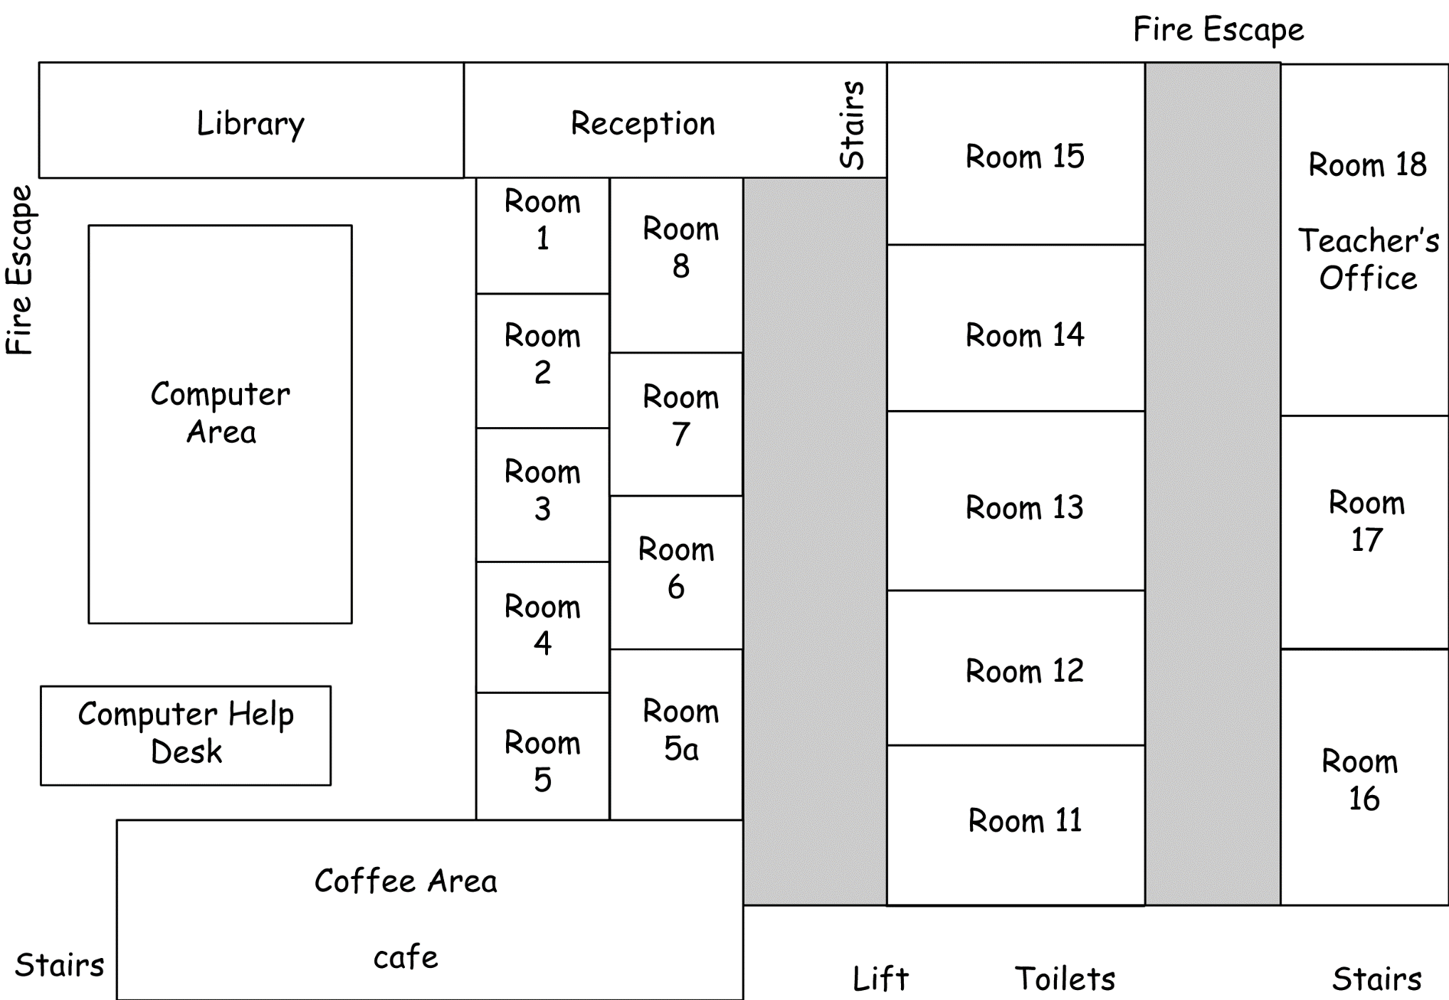

Slide 3
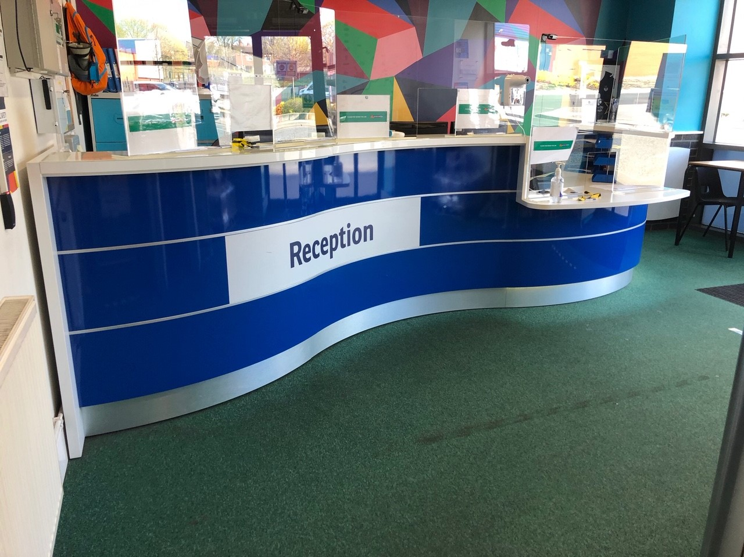
reception

Slide 4
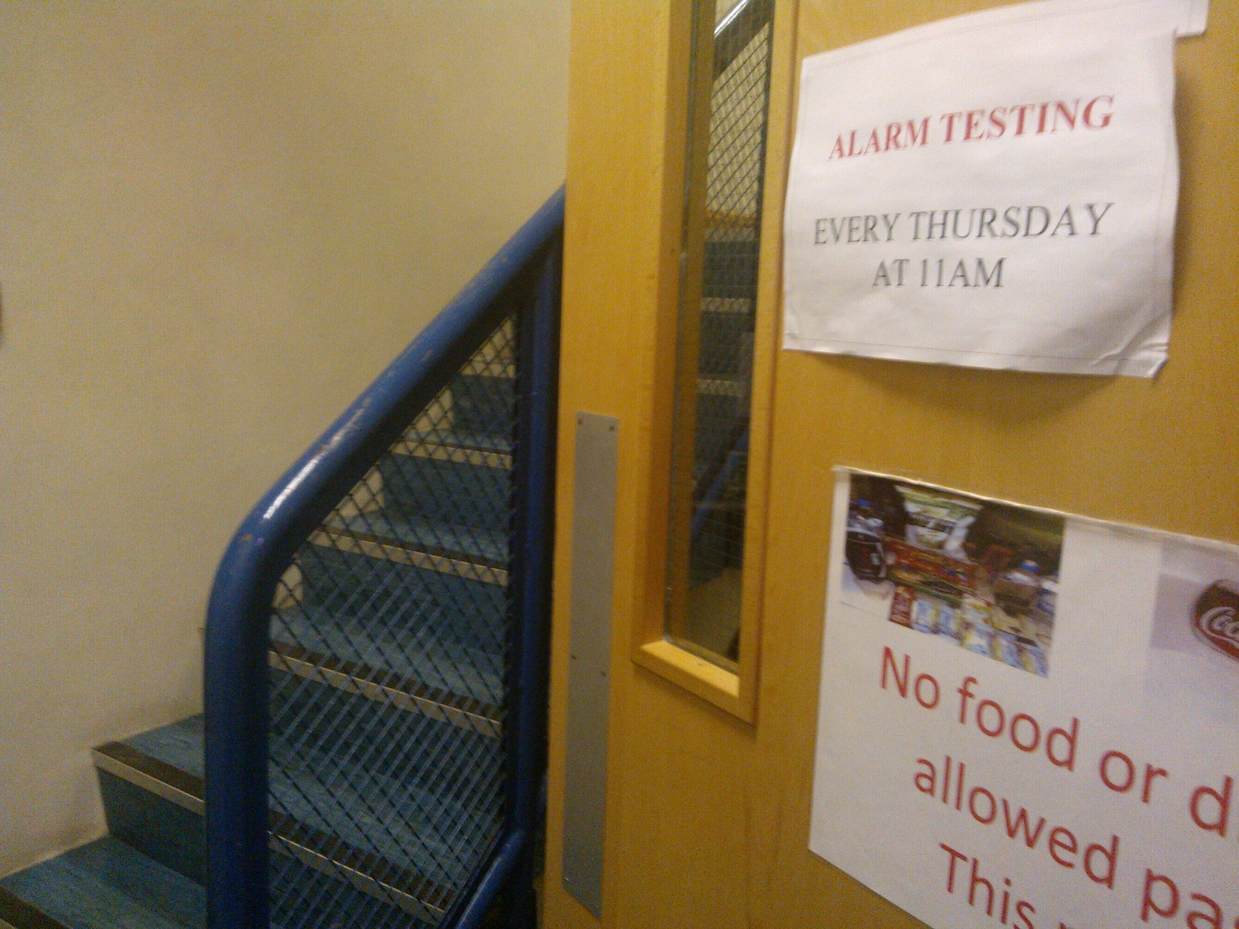
stairs

Slide 5
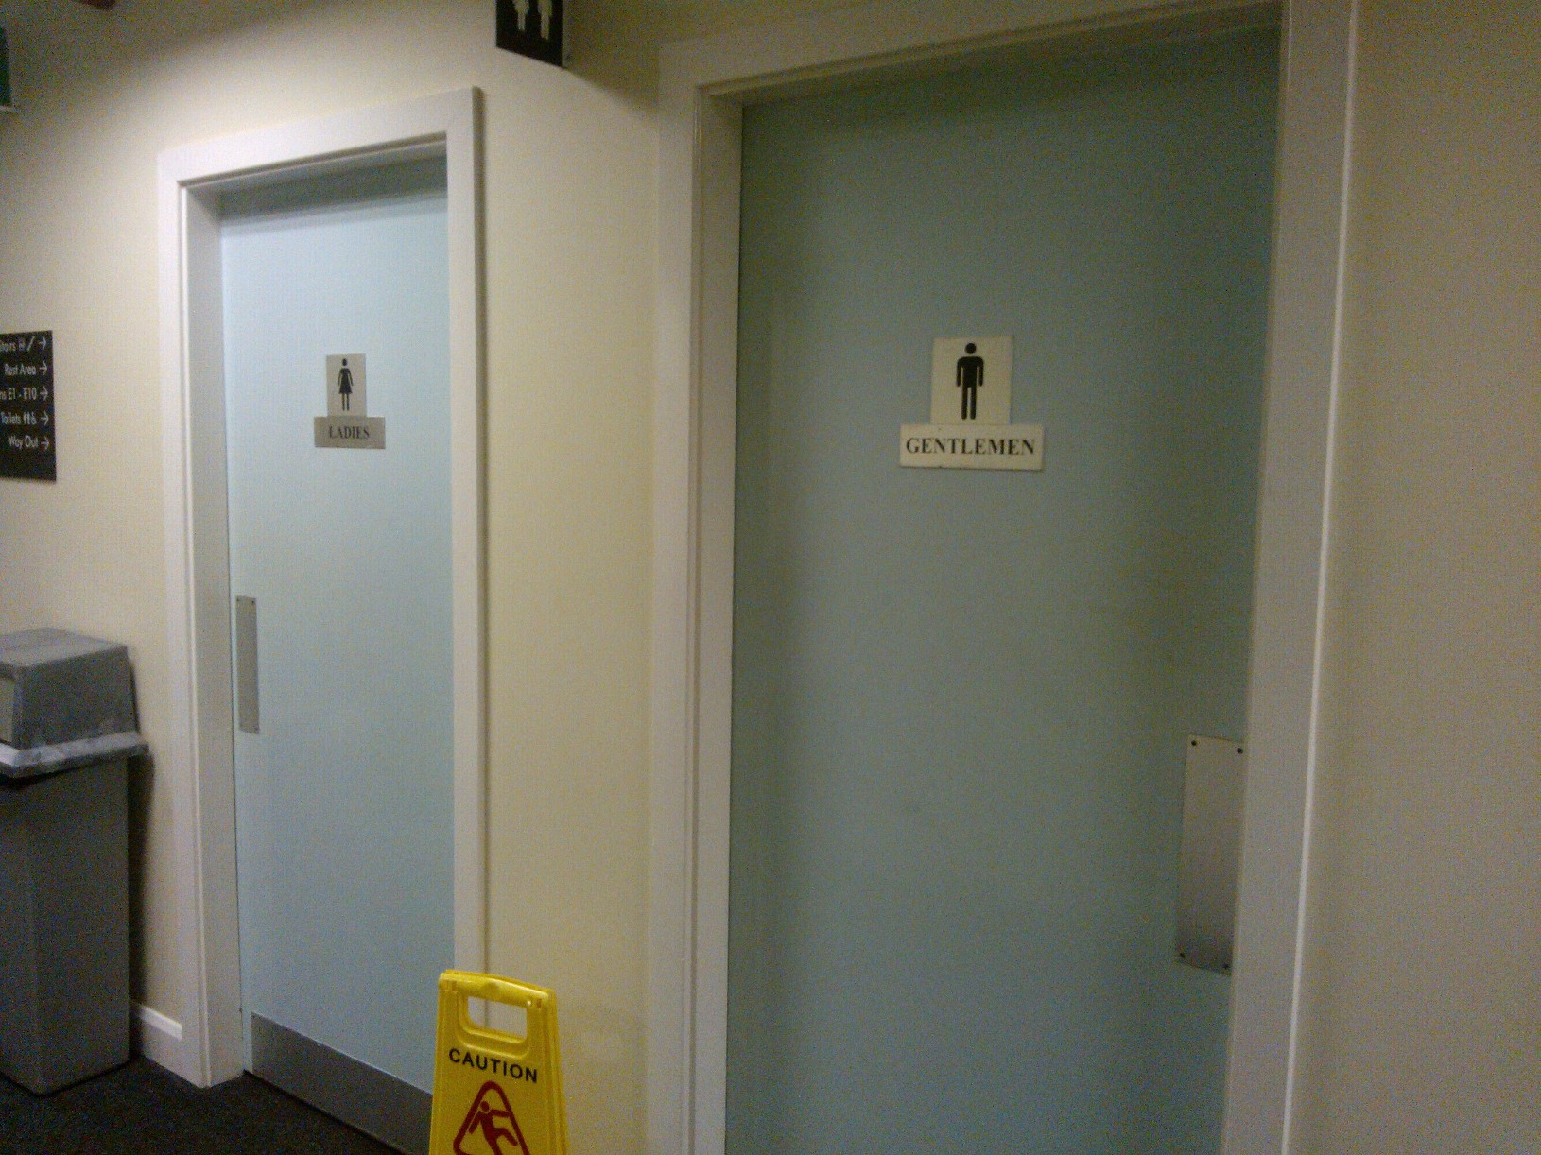
toilets

Slide 6
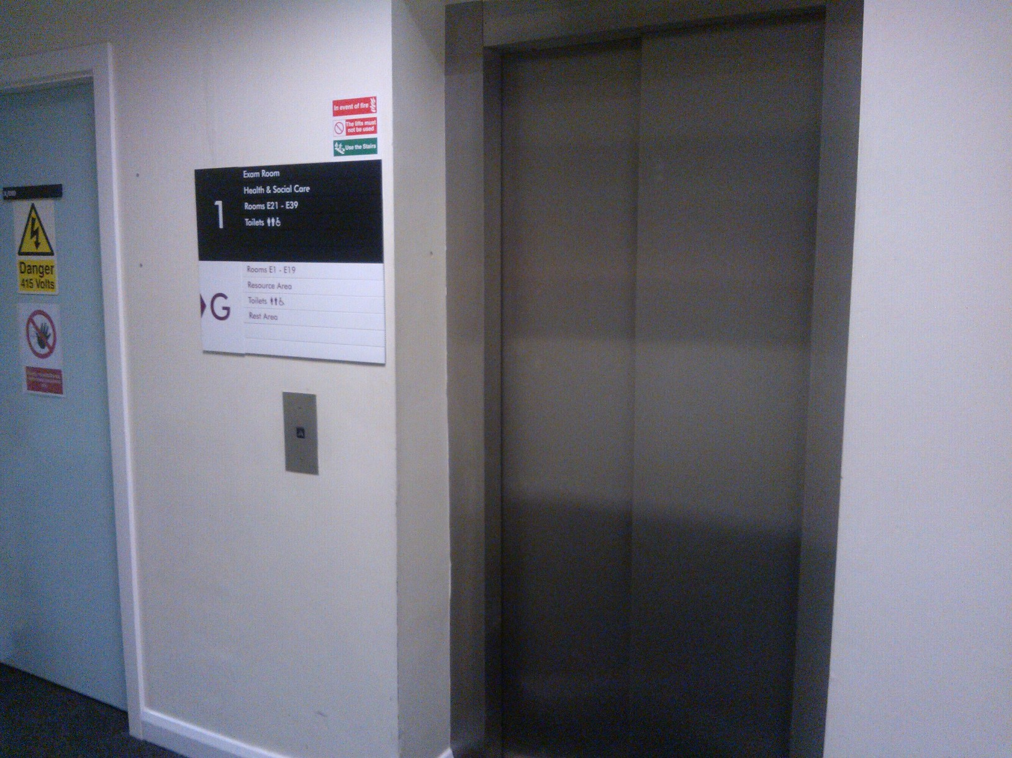
lift

Slide 7
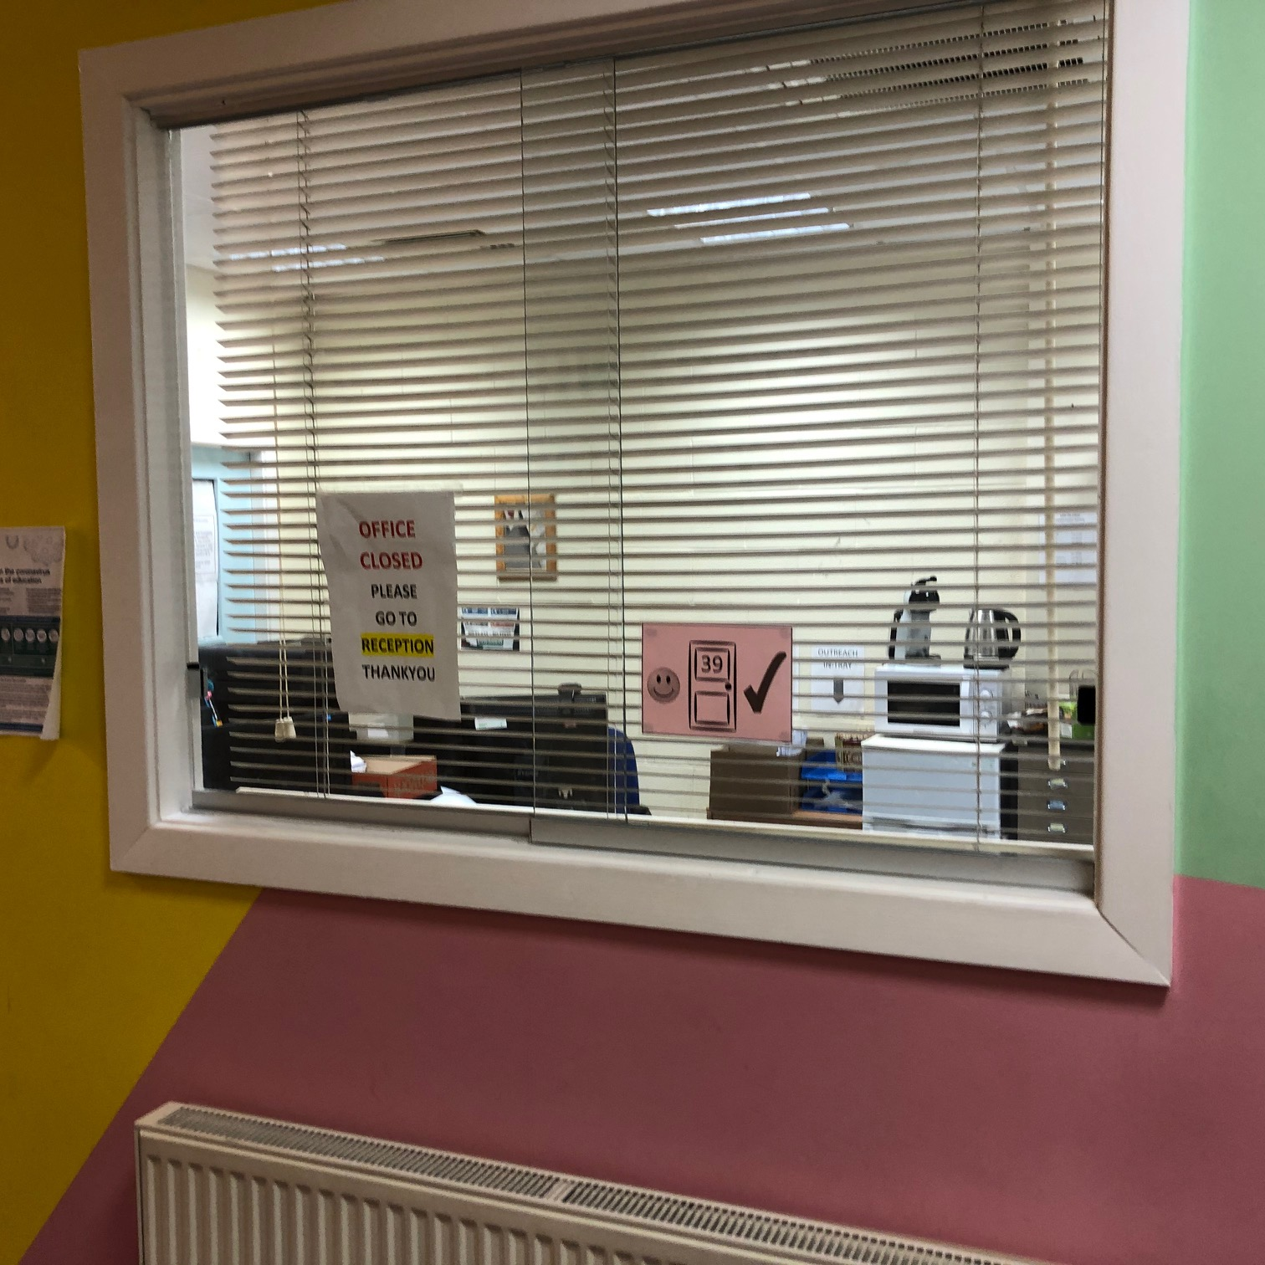
office

Slide 8
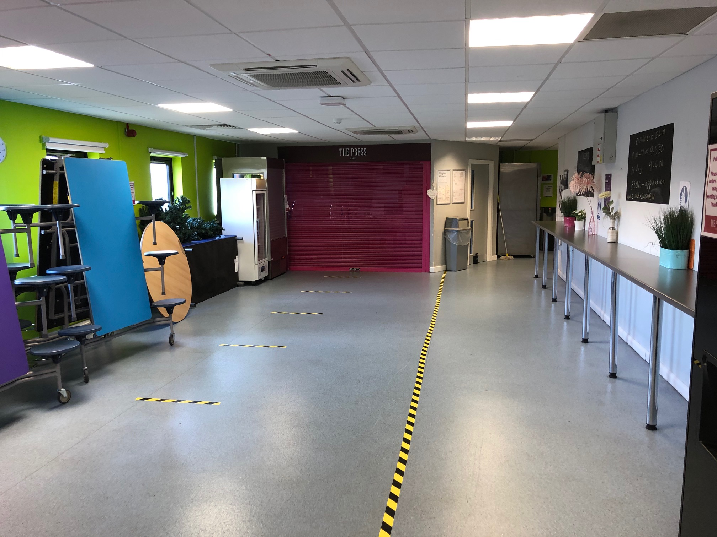
coffee area
cafe

Slide 9
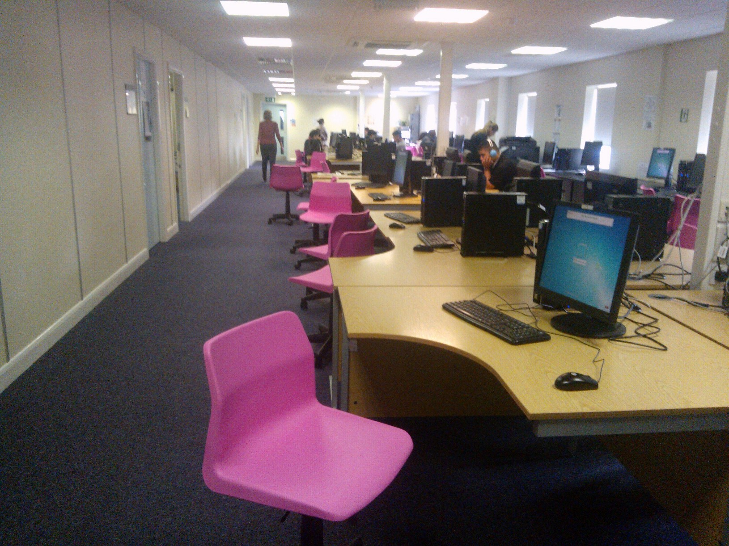
computer area

Slide 10
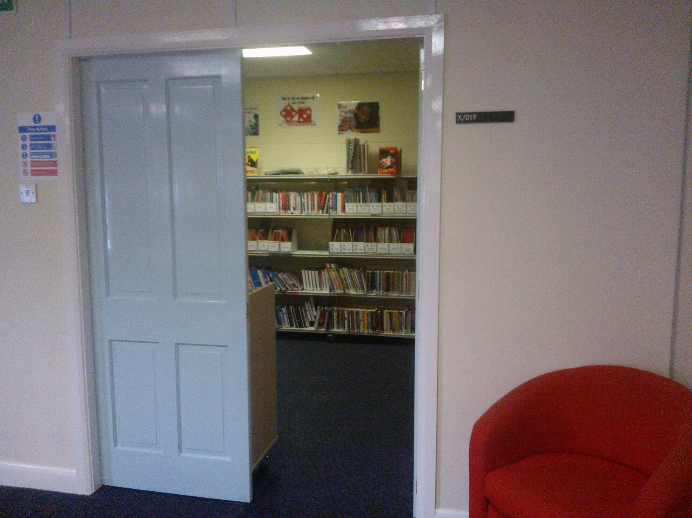
library

Slide 13
Can you help me?
How can I help you?

Slide 14
Where is the office?
The office is there.

Slide 15
start again
end show
slide 1

